Slide 1
Test-Driven Programming with QP Framework and PlatformIO
Nhan-Khanh Le

Slide 2
Content
Agenda:
Common Libraries – No QP
With QP – default for amdc developed QP drivers
Tutor: Only pure QP and project to run qp examples

Slide 3
PlatformIO
PlatformIO

Slide 4
Platformio.ini
Environment
Dependencies
Common Libraries – No QP
Deployment/ Development
Library File Configuration

Slide 5
QP Framework
QP

Slide 6
QP – Preliminary
extern "C" Q_NORETURN Q_onAssert(char const* const module, int location) {
// NOTE: add here your application-specific error handling
(void)module; (void)location;}
void QV::onIdle(void) { }
IntervalTimer _systick;
void QF::onStartup(void) {
float _systickPeriod = 1e6 / TICKS_PER_SECOND;
_systick.priority(QF_AWARE_ISR_CMSIS_PRI);
_systick.begin(sys_tick_handler, _systickPeriod);
}
void sys_tick_handler() {QF::TICK_X(0, (void*)0);}
Implement global error handler (blink code, etc.)
This is called, when there is nothing to do. Perform cleanup, go to power saving mode, etc…
Provide a base clock for the framework via hardware timer/counter!
Send ticks to QP Framework

Slide 7
QP – Preliminary
void setup() {
// Initialize framework
QP::QF::init();
static QSubscrList subscrSto[MAX_SIG];
QF::psInit(subscrSto, Q_DIM(subscrSto));
static QF_MPOOL_EL(GyroMessage) smlPoolSto[50];
QF::poolInit(
smlPoolSto,
sizeof(smlPoolSto),
sizeof(smlPoolSto[0]));
// Run
QP::QF::run();
}
Initialize Publisher-Subscriber infrastructure, where MAX_SIG is the largest signal ID that can be handled.
Initialize memory pool for messages. Use the message with the LARGEST size in your system as reference!
Number of messages that can be stored
Message for queue dimensioning

Slide 8
QP – Vanilla Kernel
#include "qpcpp.hpp" // QP/C++ framework API
// For project specific application, we have to …
#include "bsp.hpp" // Board Support Package interface
// Our developed drivers and protocols for teensy 4.1
QP examples use this file to declare the MCU dependent configuration.
Common QP callback functions and variables for Teensy 4.1 are declared and defined in <QPT4Drivers/QVConfig.cpp>

Slide 9
Using Q_SPY
These weak functions are declared in <QPT4Drivers/QSpyConfig.cpp>.
Any specific project can override these functions.
This file is compiled only if the Q_SPY build-flag is set i.e., -D Q_SPY
bool QS::onStartup(void const* arg);
void QS::onCleanup(void);
void QS::onFlush(void);
QSTimeCtr QS::onGetTime(void);
#ifndef Q_UTEST
void QP::QV::onIdle(void); // Behaviour of idle is different when QSPY is used
#endif
void QS::onCommand(unsigned char cmdId, unsigned long param1, unsigned long param2, unsigned long param3)

Slide 10
Using Q_UTEST
These weak functions are declared in <QPT4Drivers/QutestConfig.cpp>.
Any specific project can override these functions.
This file is compiled only if the Q_SPY and Q_UTEST build-flag is set, i.e., -D Q_SPY -D Q_UTEST
void QS::onTestLoop();
void __attribute__((weak)) QS::onTestSetup(void);
void __attribute__((weak)) QS::onTestTeardown(void);
void __attribute__((weak)) QS::onTestEvt(QEvt *e);
void __attribute__((weak)) QS::onTestPost(void const *sender, QActive *recipient, QEvt const *e, bool status);
void __attribute__((weak)) QP::QS::onCommand(uint8_t cmdId, uint32_t param1, uint32_t param2, uint32_t param3)

Slide 11
QP Examples with Teensy 4.1
QP examples provide helpful scenarios to understand the design and debugging process.
You may find these examples in qp/examples/arm-cm/$YOUR_MCU/
Let‘s try to adapt some qp examples to Teensy 4

Slide 12
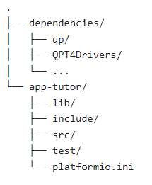
Platformio configuration
We want to use a consistent project structure
We distinguish the usage of QP, QSPY, and QUTEST only through the platformio.ini file.
Let‘s create three different development environment for QP, QSPY, and QUTEST.
→ How should we do it? (5 min thinking …) ☺
We use this project structure consistently for all QP configuration

Slide 13
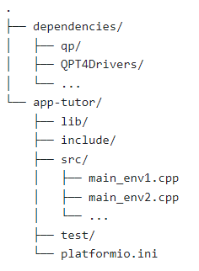
Solution
Common properties for QP projects
Project specific settings
[env:QP]
test_filter =
build_flags =
${QP_COMMON.build_flags}
[env:QSPY]
test_filter =
build_flags =
${QP_COMMON.build_flags}
-D Q_SPY
[env:QUTEST]
test_filter = test_Blinky_T4
build_flags =
${QP_COMMON.build_flags}
-D Q_SPY
-D Q_UTEST
[env]
framework = arduino
platform = teensy
board = teensy41
lib_ldf_mode = chain+
test_framework = custom
upload_protocol = teensy-gui
lib_extra_dirs =
../Dependencies/
build_src_filter
= +<*.h> +<main_${PIOENV}.cpp>
// Each env uses 1 unique main.cpp
[QP_COMMON]
build_flags =
-D QP_RATE=10000U

Slide 14
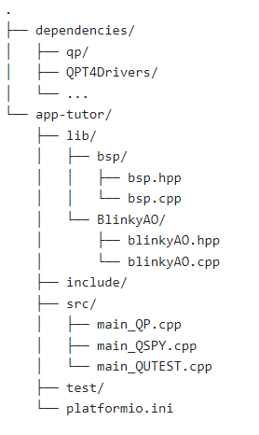
Let‘s blink - Blinky Example
From the example provided by QP, I made several adaptations and merge some modules into our tutorial project
What does this library do? Why and when do we need it?
Now, flash the QP environment and observe that the LED blinks.
QUIZ ☺
What is the blinking frequency?
Can you adjust the blinking frequency?

Slide 15
Brief Summary
After this slide, you should …
Understand the „environment“ concept of platformio.ini;
Understand how the dependencies are declared;
Understand how to configure any QP project.

Slide 16
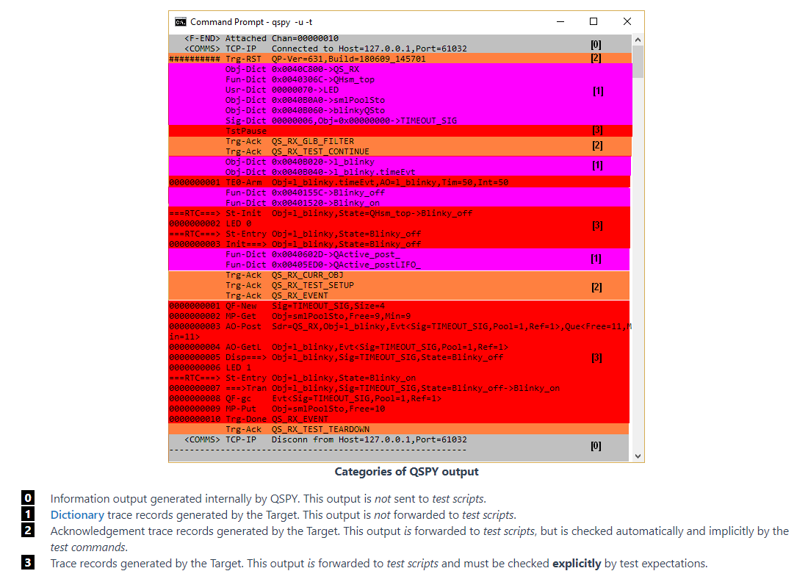
Q_SPY
Records
Teensy
PC
Commands
Dictionary declaration (human-readable)
Records:
State machine
Events
User-defined logs
Users can command qspy

Slide 17
Let‘s blink with Q_SPY - Blinky Example
You must install QP-bundles to use QSPY and QUTEST.
Now we extend the qp project using Q_Spy to see something on the screen.
Flash this file „main_QSPY.cpp“ please!
How did you do it?
Is QSPY really activated?
Is the teensy blinking like before?
Open command prompt, input
qspy –c COMXXX –b 115200 […]
Check this link for additional info about qspy
https://www.state-machine.com/qtools/qspy.html

Slide 18
Q_SPY
What do you see on the Q_SPY terminal?
How do you interprete these information?
Press „i“ in the terminal that is running qspy, what happen?
Press „r“ in the terminal that is running qspy, what happen?
Quiz:
What should you do if the qspy records contain register numbers or any information that you can not understand ?
How do you save the qspy records into a text file for later usage?
You may see qspy using the timestamp at microseconds. How can we change to millis()?

Slide 19
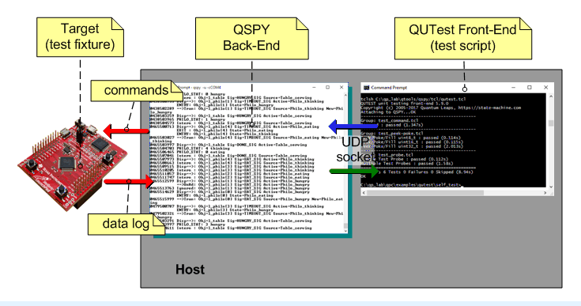
QUTEST
Teensy
PYTHON scripts
Check this out
https://www.state-machine.com/qtools/qutest.html

Slide 20
QUTEST
To achieve a deterministic behaviour, QUTEST triggers RESET on the MCU multiple times.
This is not a problem on many MCUs. Since the USB or COM-Port connection is maintained while MCU performs a reset, QSPY is still alive.
However, reset on Teensy interrupts the COM-Port connection → QSPY automatically exit. This explains why qspy exits when we press „r“.
We need a mechanism to keep the QSPY alive while Teensy is being reset.
qrelay.py

Slide 21
qrelay.py
Console 1:
qspy –t 6601 –u 7701
Console 3:
running qutest scripts
Teensy
UDP
Serial
TCP
You have to stop the qrelay.py to upload new codes on teensy.
Use ctrl+c and restart the script
QspyRelayPort:
qrelay.py
Console 2:
python qrelay.py COMXXX 6601

Slide 22
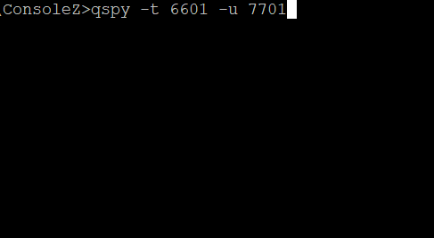
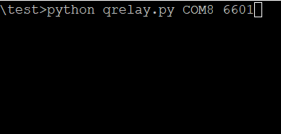
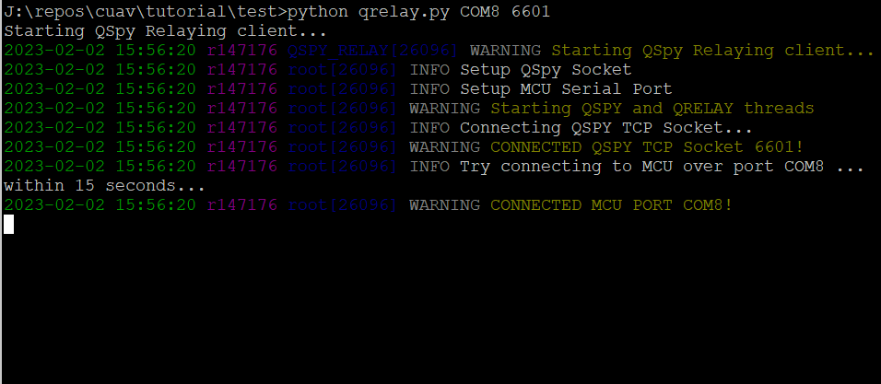
qrelay.py
Now qspy will always be alive.
Push the reset button on teensy, what happen?
Press „i“ in the qspy console, what do you see?
Try „r“ (reset teensy with qpsy), is the qspy console still alive?

Slide 23
Let‘s test the Blinky Example
You must install QP-bundles to use QSPY and QUTEST.
Now we extend the blinky project using Q_UTEST
Flash this file „main_QUTEST.cpp“ please!
How did you do it?
Is QSPY and QUTEST really activated?
Is the teensy blinking like before? Why?
Now I want to see some qspy records with qrelay.py. How do you do it?

Slide 24
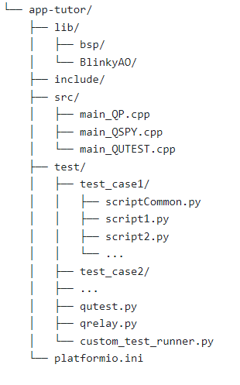
Let‘s run Q_UTEST
Console 1:
qspy –t 6601 –u 7701
Console 2:
python qrelay.py COMXXX 6601
Let‘s run the Qutest.
Open another command prompt, change to the test directory
Execute:
Quiz
Is Qutest running?
Did you pass the test? If not, why?
Is it a bug? Can you fix it?
Console 3: test>
python qutest.py test_Blinky_T4/*.py “” localhost:7701
When do we need this?
QP domain language
Notes:
Solution:
File bsp.cpp, line init → uncomment the LED Sig declaration

Slide 25
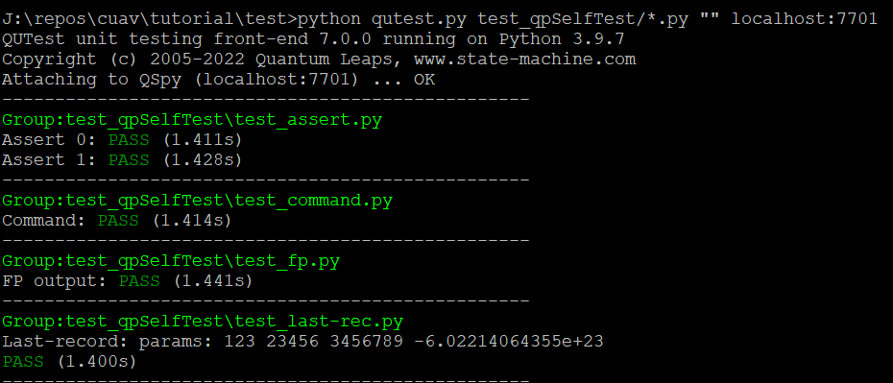
Quiz
Now, can you update the main_QUTEST.cpp so that we upload the test case „test_qpSelfTest“?
Run the test script such that the test result should look like this …

Slide 26
Unit Testing with - PlatformIO custom_test_runner.py
Now we have to use 3 terminals for testing with qutest → Is there any convenient way to automate this process?
PlatformIO offers a unit-testing framework. Add this line to the environment setup
test_framework = custom
Have a look at the file custom_test_runner.py
Intuitively, we can see that
custom_test_runner is
PlatformIO-TestClass + qrelay.py
+ thread (qspy) + thread (qutest)

Slide 27
Adjust the test_filter to select a particular test for each environment, else pio test will execute all found tests
For example
test_filter = test_Blinky_T4
→ Only test the scripts and the fixture in folder test_Blinky_T4.
Click Test, what do you see?

Slide 28
Test Driven Development
Test-Driven Programming:
Use case → the needed requirement and information → development
Note: Not predict the error, but increase the merge and developed confidence
Now, lets extend the Blinky class so that it is more advanced!

Slide 29
Discussion

Slide 30
Back Log

Slide 31
QSPY Logging and Visualization
Teensy
COM
QTools
Matlab
QSPY Record (binary)
QSPY Record (Readable)
Evaluation
Qspy logging – C++ level
Decide the logging rate
Decide the logging format
What should we log?
How often should we log?
Write an adapter to feed the logged record into the QTools program. (Python/C++)
Qtools returns a readable human file.
Qtools also returns helpful diagram such as sequential diagram
Write a Matlab parser to get the interested values from the Human-readable file
Plot the data

Slide 32
Synchronization between SFU CCU MC
SYNC_REQUEST
SFU
CCU
SYNC_READY
MC
SYNC_TRIGGER
SYNC_TRIGGER
SYNC_CONFIRM
What if SYNC_TRIGGER from CCU to SFU doesn‘t arrive?

